Slide 1
PIZZA OUTLETS
Presented by:
Kanaad D S 1NT19CS092
Chinmay Ganapati Hegde 1NT19CS059
Ajit Hegde 1NT19CS018
Krishnamurthy M Naik 1NT19CS097
Under the guidance of :
DR . VIJAYA SHETTY S
Associate Professor, Dept. of CSE, NMIT

Slide 2
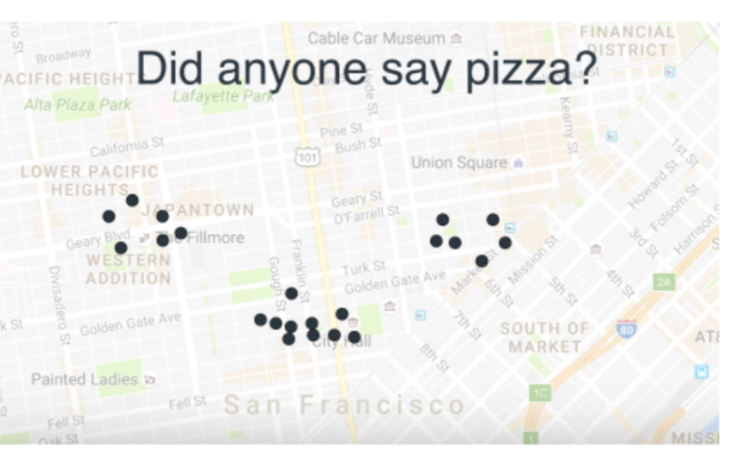
Problem Statement
Given the list of locations of customers who frequently order pizza we want to find out the optimal locations of pizza outlets where they should be opened.

Slide 3
Clustering :
Unsupervised learning: no predefined classes i.e., learning by observations.
Cluster: A collection of data objects that are-
similar (or related) to one another within the same group
dissimilar (or unrelated) to the objects in other groups

Slide 4
Major Clustering Approaches
Partitioning approach:
Construct various partitions and then evaluate them by some criterion, e.g., minimizing the sum of square errors
Typical methods: k-means, k-medoids, CLARANS
Hierarchical approach:
Create a hierarchical decomposition of the set of data (or objects) using some criterion
Typical methods: Diana(Divisive Analysis), Agnes(Aglomerative Nesting), BIRCH, CAMELEON
Density-based approach:
Based on connectivity and density functions
Typical methods: DBSCAN, OPTICS, DenClue
Grid-based approach:
based on a multiple-level granularity structure
Typical methods: STING, WaveCluster, CLIQUE

Slide 5
K-means algorithm
Algorithm: k-means. The k-means algorithm for partitioning, where each cluster’s center is represented by the mean value of the objects in the cluster.
Input:
k: the number of clusters,
D: a data set containing n objects.
Output: A set of k clusters.
Method:
(1) arbitrarily choose k objects from D as the initial cluster centers;
(2) repeat
(3) (re)assign each object to the cluster to which the object is the most similar,
based on the mean value of the objects in the cluster;
(4) update the cluster means, that is, calculate the mean value of the objects for
each cluster;
(5) until no change;

Slide 6
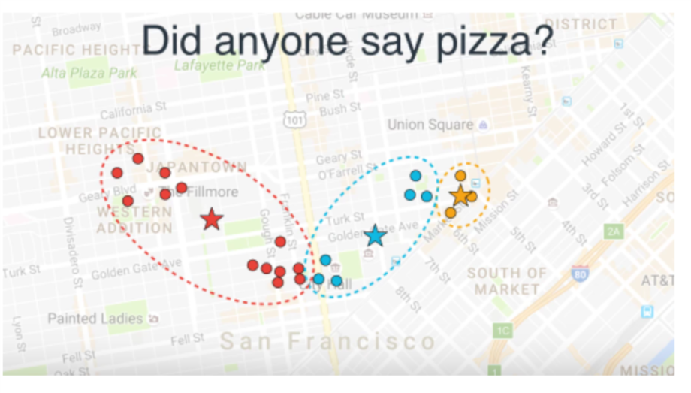

Slide 7
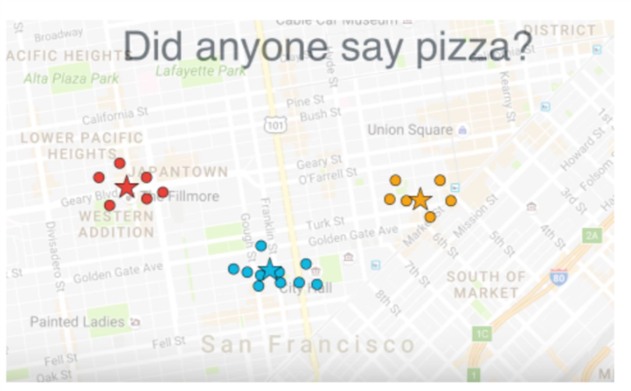

Slide 8
Let’s move towards code now…

Slide 9
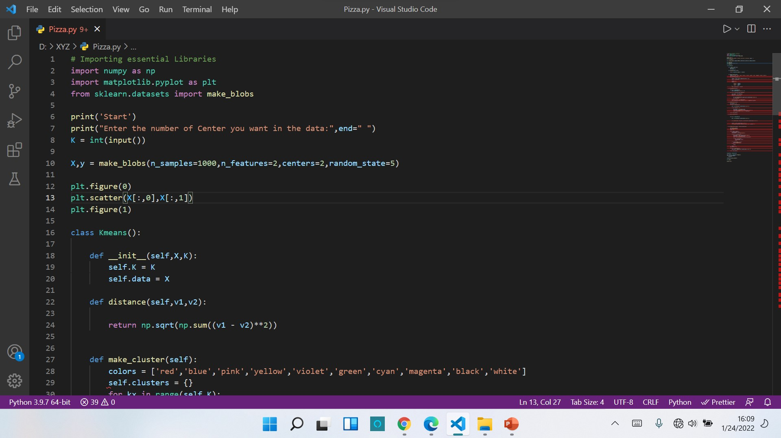

Slide 10
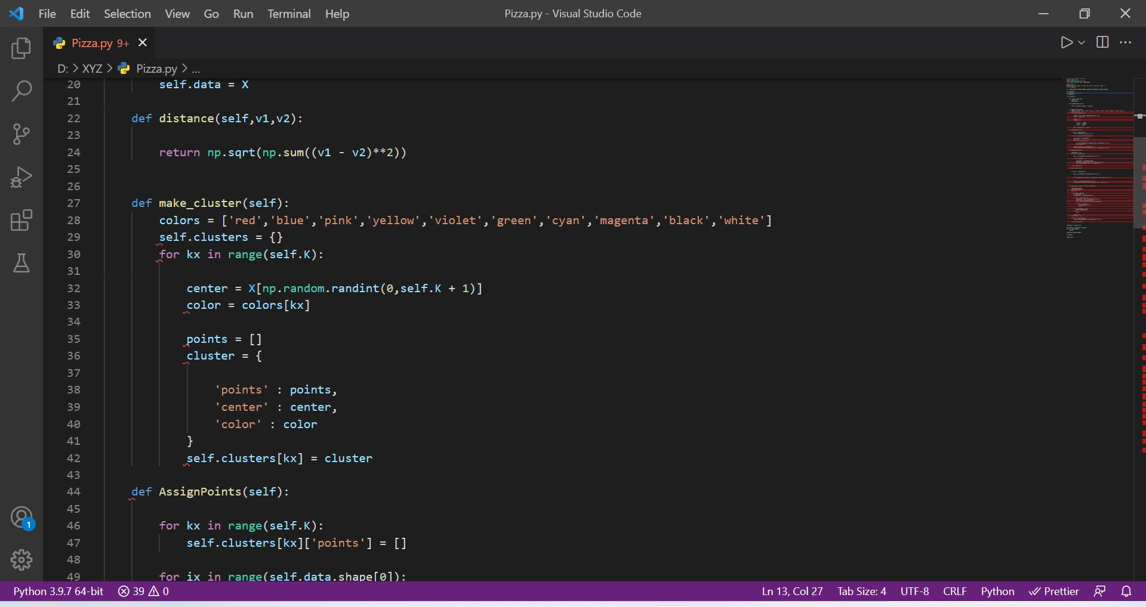

Slide 11
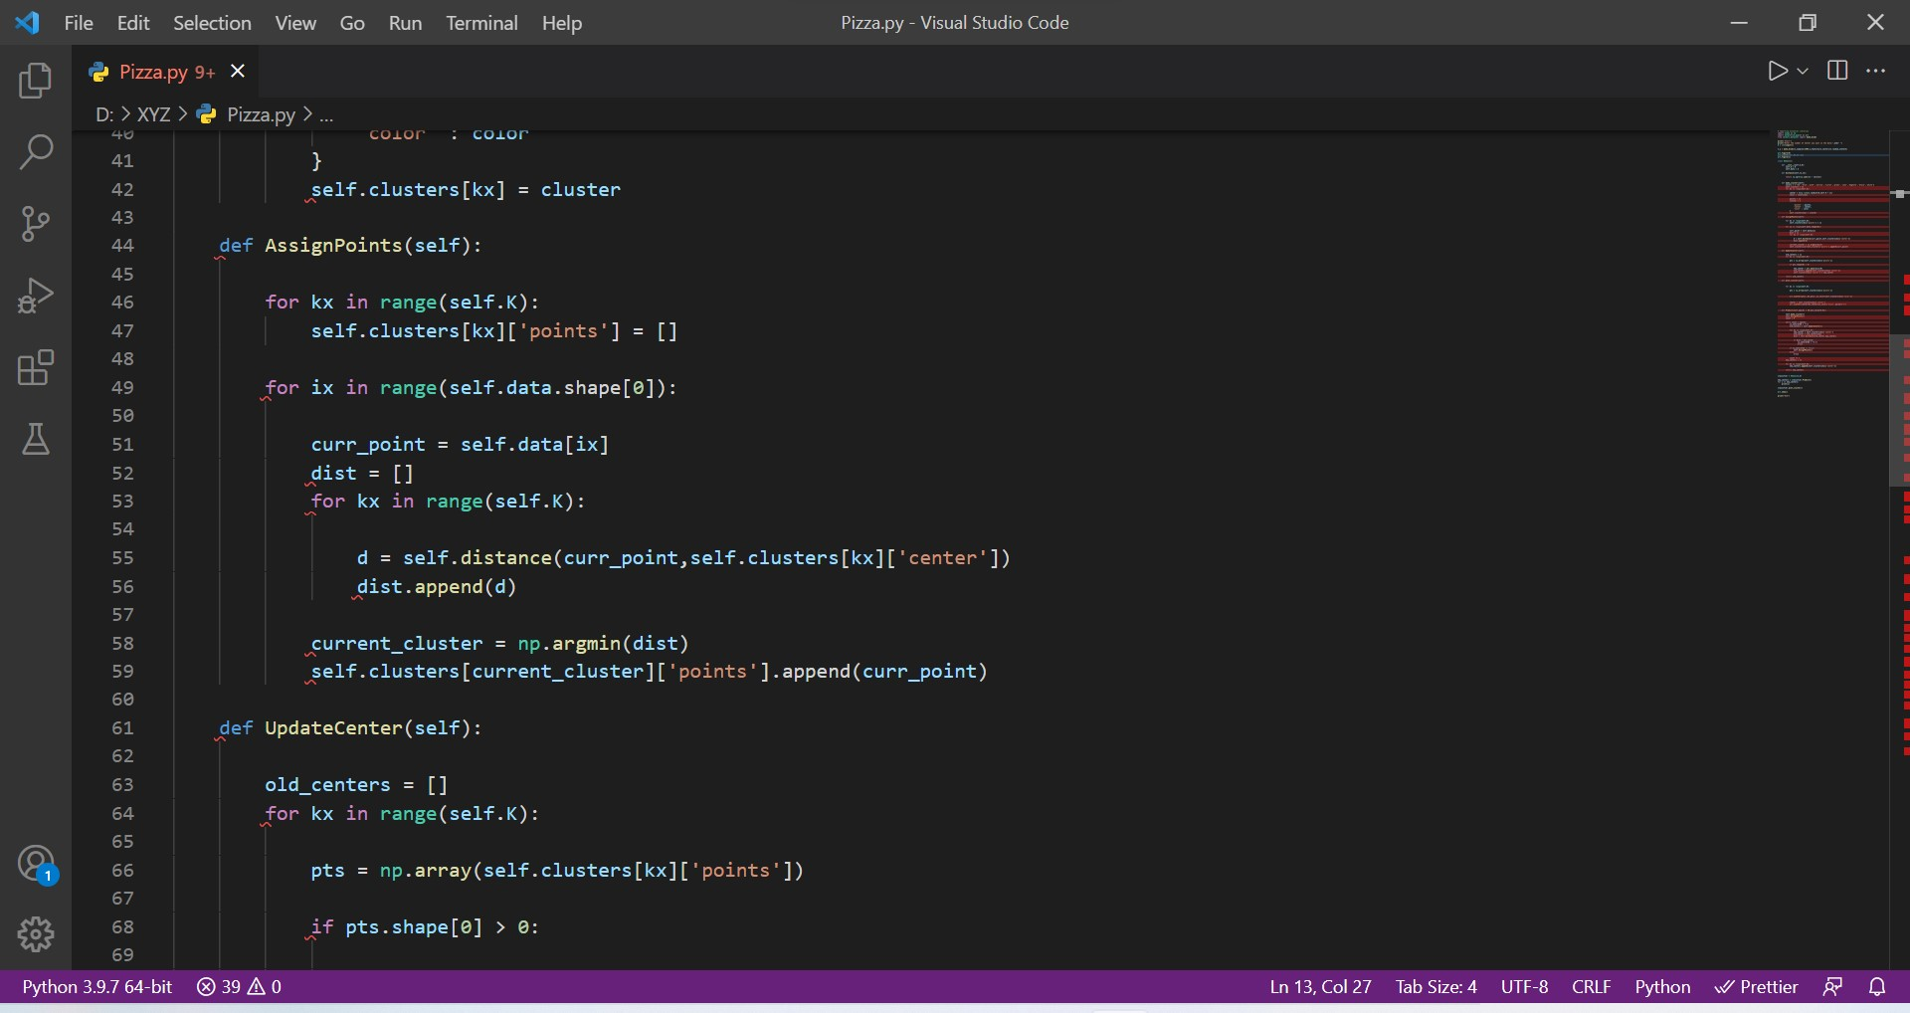

Slide 12
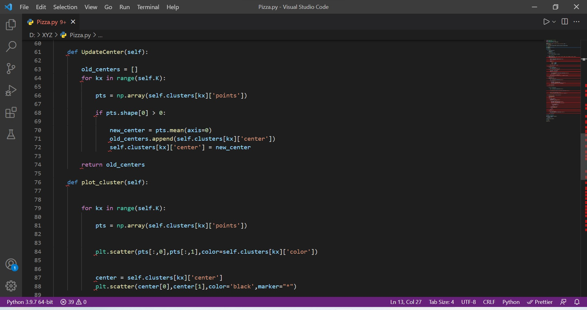

Slide 13
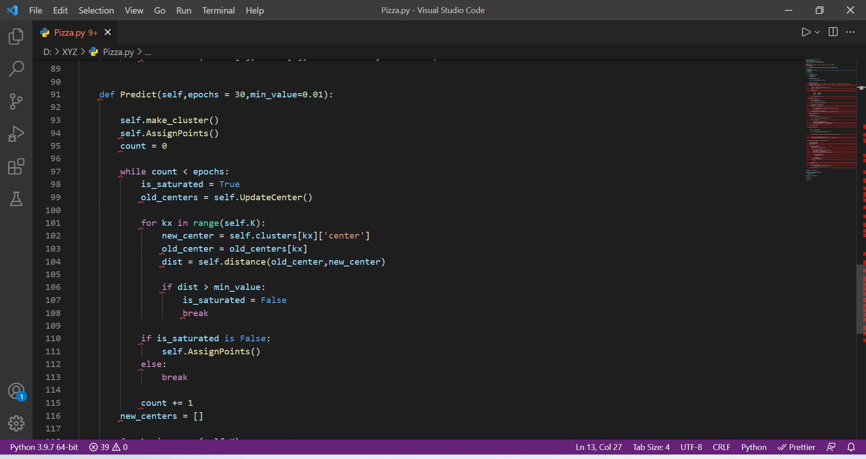

Slide 14
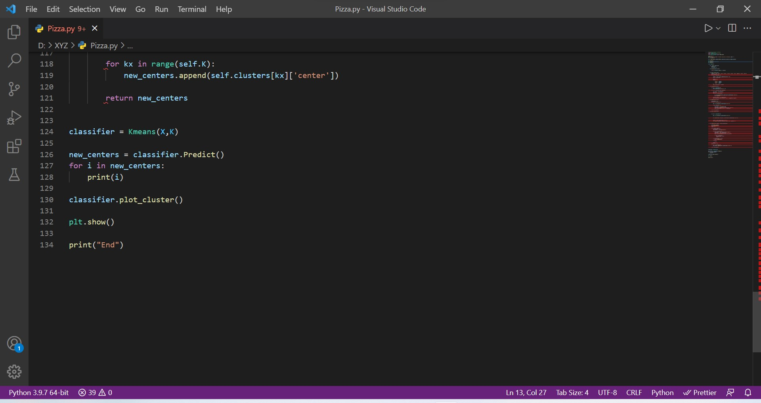

Slide 15
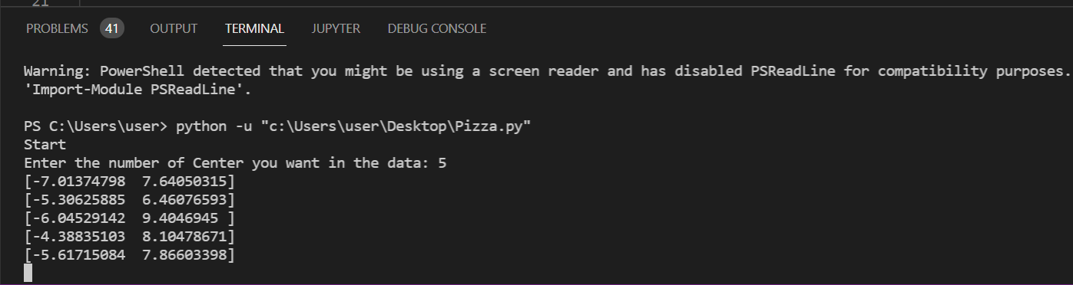

Slide 16
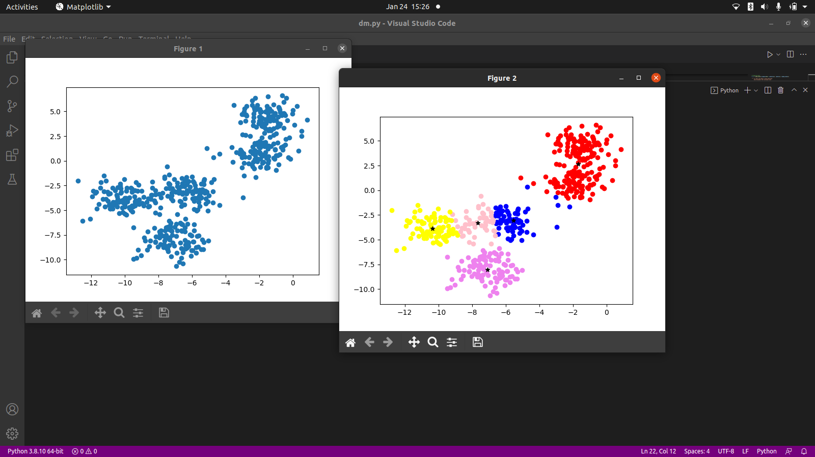

Slide 17
Thank You…

